Slide 1
Exercises on Closeness and Betweenness

Slide 2
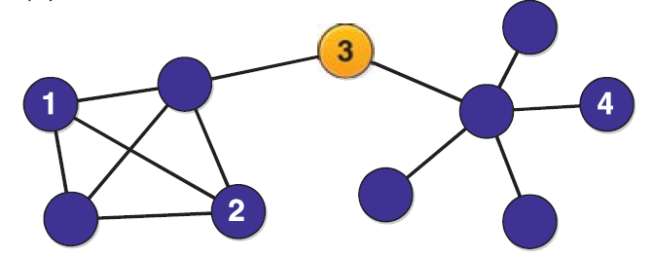

Exercise 1
What is the betweenness of nodes $1, 2, 3, 4$?
Solution
$B_{1}=B_{2}=B_{4}=0$. No shortest path crosses these nodes.
$B_{3}=\frac{1}{\left({9 \atop 2}\right)}⋅\left(4⋅5\right)=\frac{20}{36}=\frac{5}{9}≈0.56$.

Slide 3
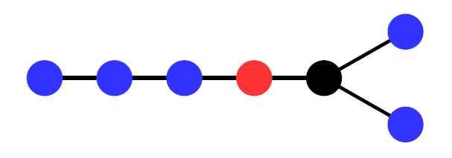
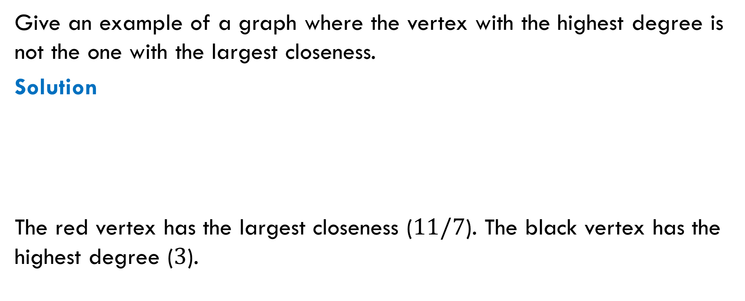
Exercise 2
Give an example of a graph where the vertex with the highest degree is not the one with the largest closeness.
Solution
The red vertex has the largest closeness ($11/7$). The black vertex has the highest degree ($3$).

Slide 4
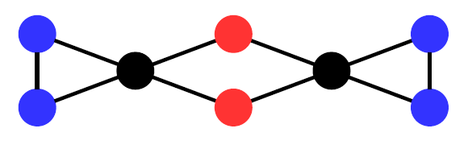
Exercise 3
Give an example of a graph where the vertex with the largest betweenness is not the one with the largest closeness.
Solution
The black vertices have the largest betweenness. The red vertices have the largest closeness.

